Slide 1
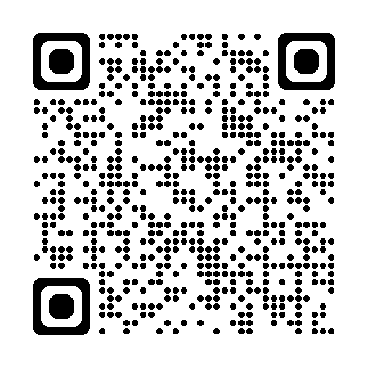
Fall 2026: Upcoming Workshops
Data Analysis Support Hub
Digital Research
Research Data Management
September 24: Responsible Research Assessment (Research Practice Exchange)
October 29: Data Horror Stories (Research Practice Exchange)
Do More with Digital Scholarship
Register for Upcoming Workshops: https://u.mcmaster.ca/scds-workshops

